Slide 1


Machine Learning Usage at Futures Sport and Entertainment
Chris Felstead
Lead Software Engineer

Slide 2
Who are we?
We work with the world's most famous clubs, federations and sponsors.
We use proprietary in-house software and analytical techniques to track assets and exposure for rights holders and sponsors.

Slide 3
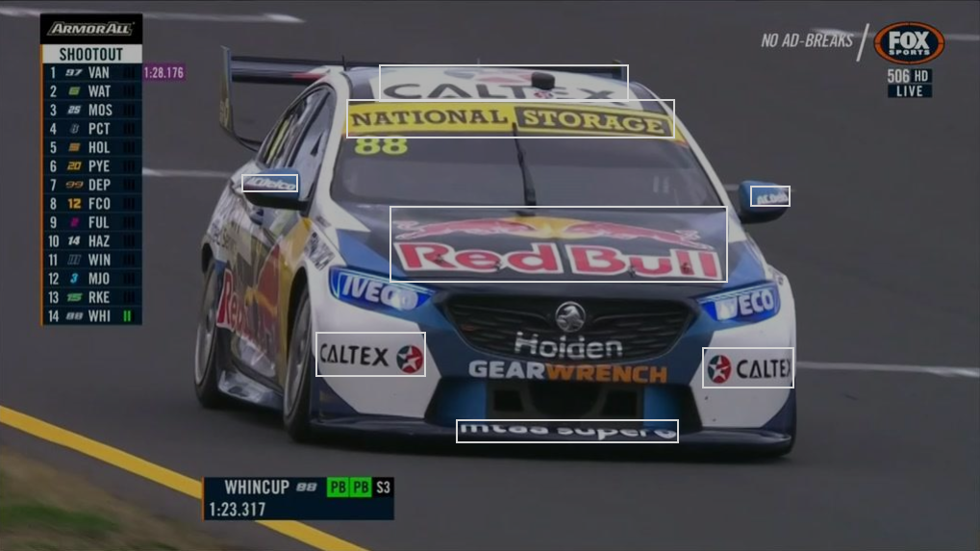
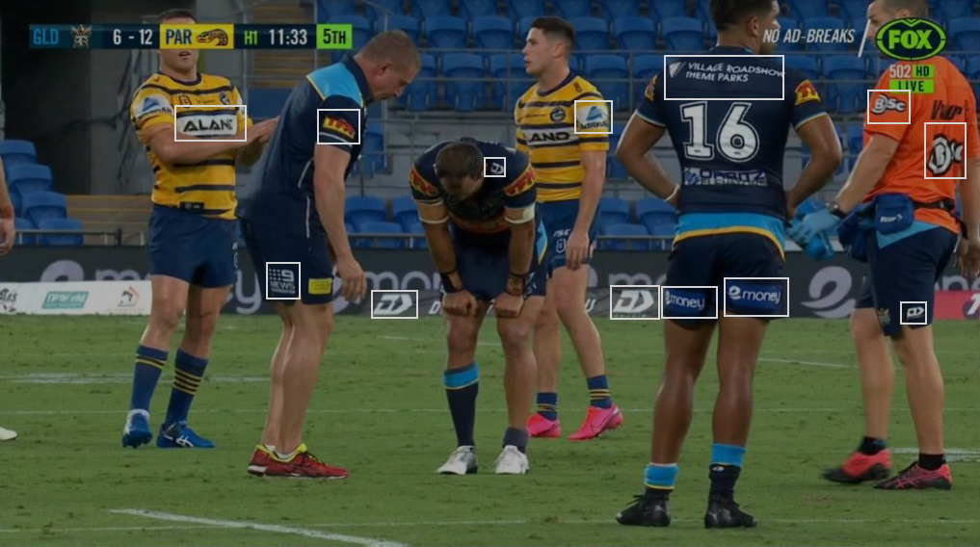
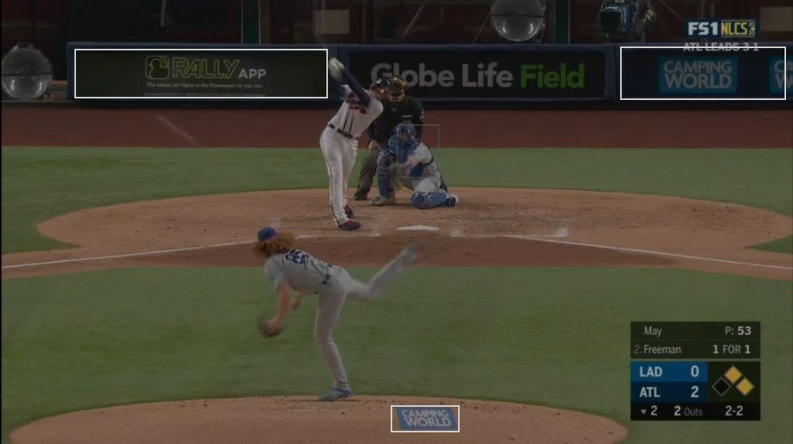
How Do We Use Machine Learning?
In order for us to provide an accurate value of a sponsorship, we need accurate data. The best way of achieving this, is to process footage from a sports event and track the sponsors, physical surface, location on the screen and time on the screen.

Slide 4


Footage Analysis
Computer Vision (specifically the Read API)
could return a simple dataset quickly with
no need for training.
Custom Vision
provides us additional capabilities such as detecting the sponsorship surface and identifying logos that are not textural in nature.

Slide 5
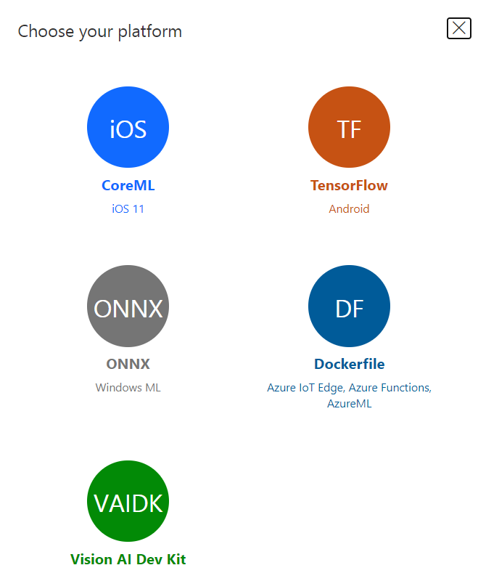
So, Where Does ML.NET Come In?
In instances where we have
A small model with only a few tags
A static model with not many changes
A large number of images that will contain no results

Slide 6
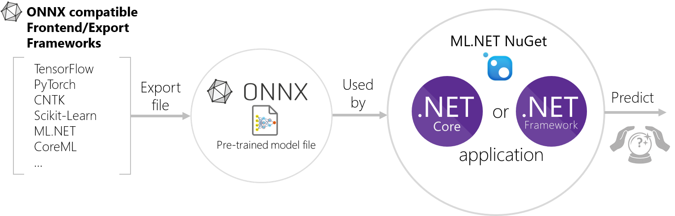
So, Where Does ML.NET Come In?
ML.NET gives us the opportunity to export the model created and trained through Custom Vision and process it wherever it is most cost effective for us.
It also gives us the capability to upload our trained models to our clients web portals and have them send us images for analysis and reporting on.

Slide 7
Demo
Let's see an exported model in action

Slide 8
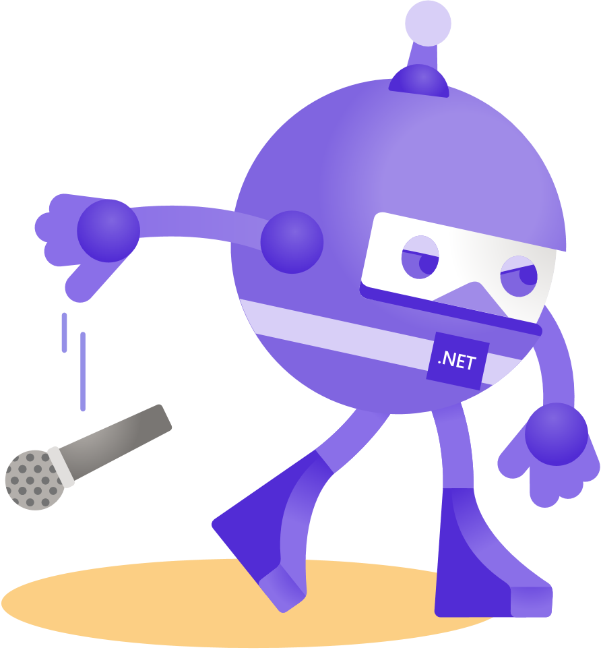
Thanks for joining!

